Slide 1
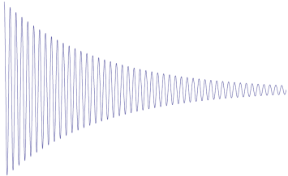


(a)
$$π/2$$
$$π/4$$
t2
t1
H5
H1
H4
H2
H3
(b)
H3
H2
H4
Parallel:
Cross:
Diagonal
H1
H5

